Slide 1

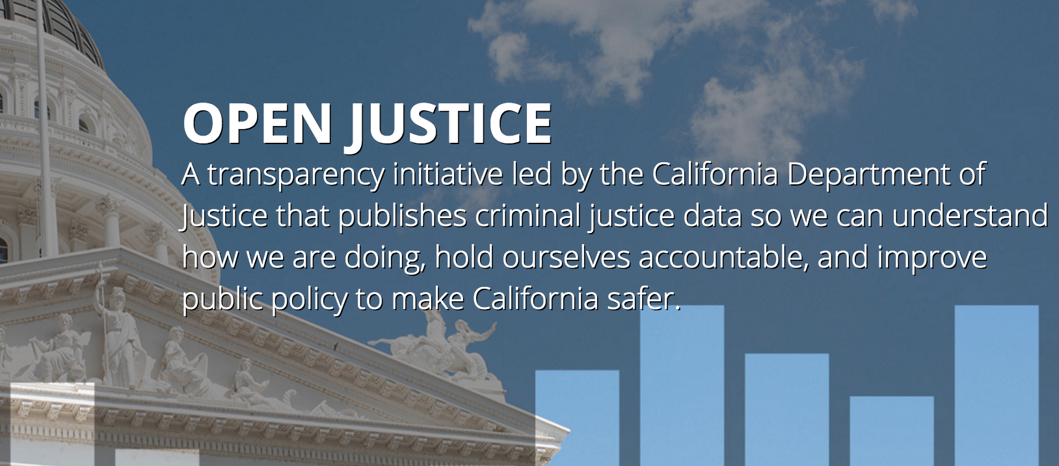
OpenJustice.doj.ca.gov
Notes:
AG SPEAKING CUE: BCJ

Slide 2
Vision For OpenJustice
Ongoing national conversation on how to strengthen trust and improve performance of the criminal justice system
Smart on Crime approach – transparency & metrics
Embrace transparency to strengthen trust
Use data & metrics to understand how we are doing and where to prioritize interventions
Focus on equity, effectiveness, and efficiency
Four key components
Open Data Portal to make raw data available to public
Data stories that share insights on datasets
Justice Dashboard to show visually how we are doing
Data reporting/collection improvement effort

Slide 3
OpenJustice Theory of Change
Collect
Analyze
Publish
Engage
Good data
Improve quality of existing data
Move towards more real time reporting
Add new right data fields
Share across agencies
Rigorous analytics
Bring big data methodologies
Partner with researchers
Identify policy improvements
Transparency
Release raw data
Lift up clear and actionable insights
Crowdsource data analysis
Share policies that are working
Awareness
Engage policy makers and local criminal justice partners
Inform the community to build trust

Slide 4
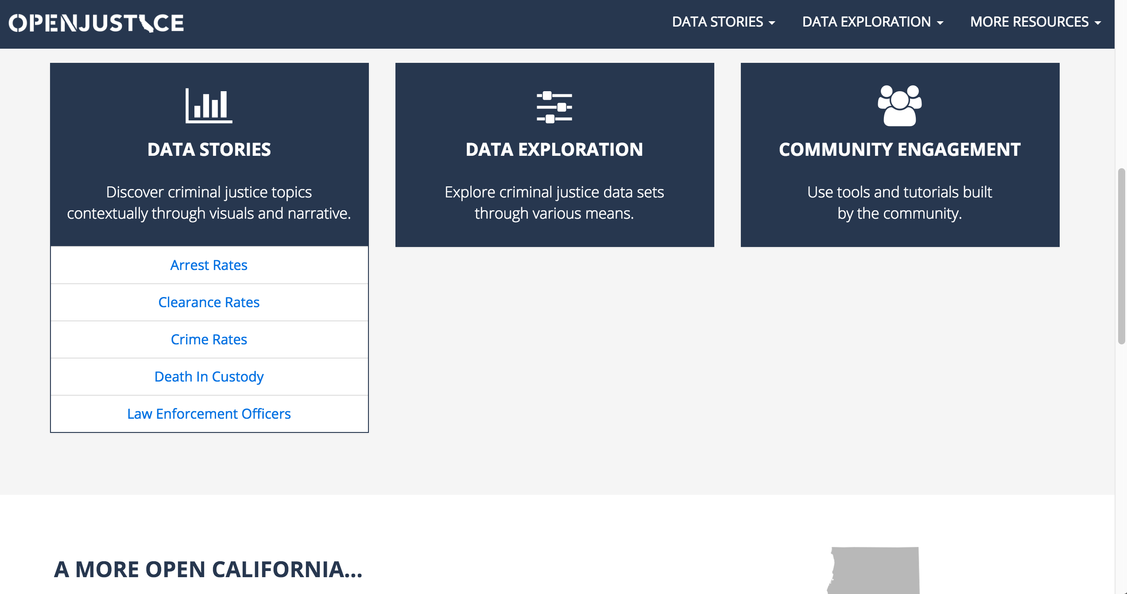
We’ve released five data stories and
tools to explore the data further

Slide 5
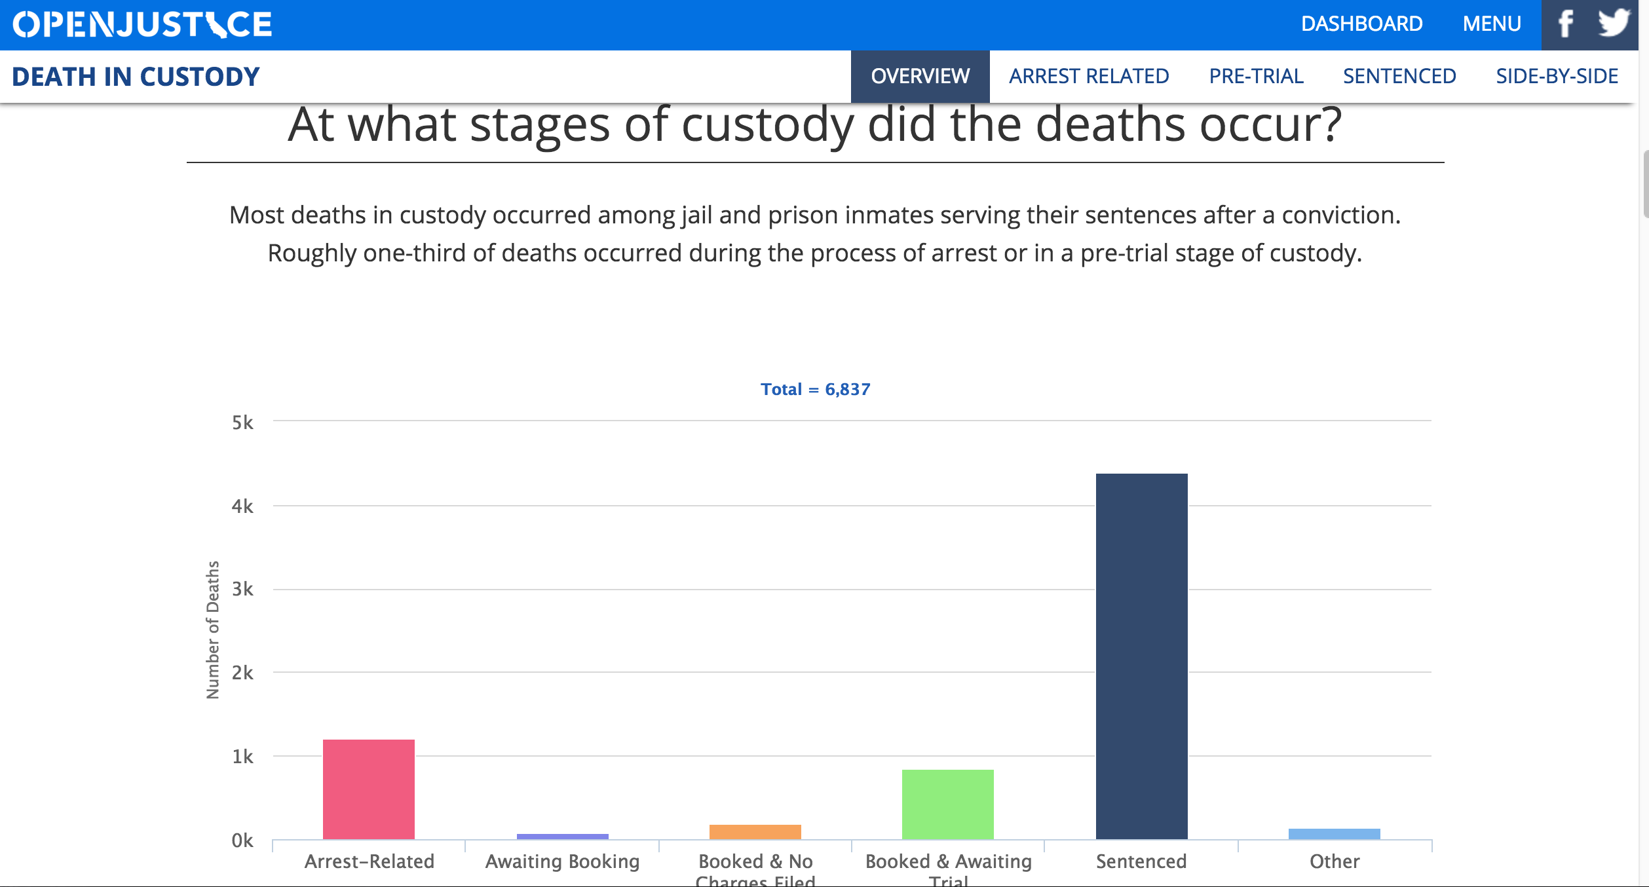
Data stories answer questions to give the public a clear state-wide picture

Slide 6
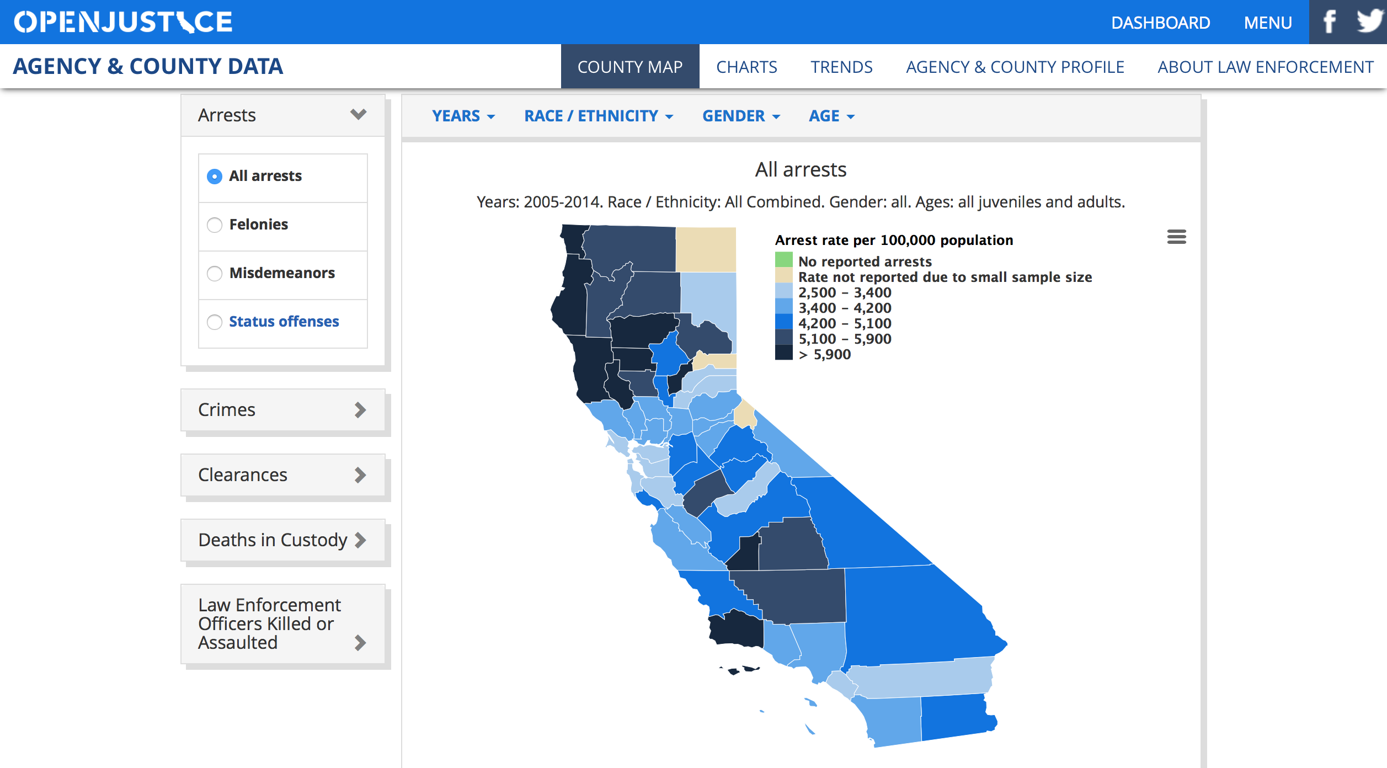
Shows differences across counties and agencies throughout the state
Includes contextual data such as pop. demographics, education, employment, etc.

Slide 7
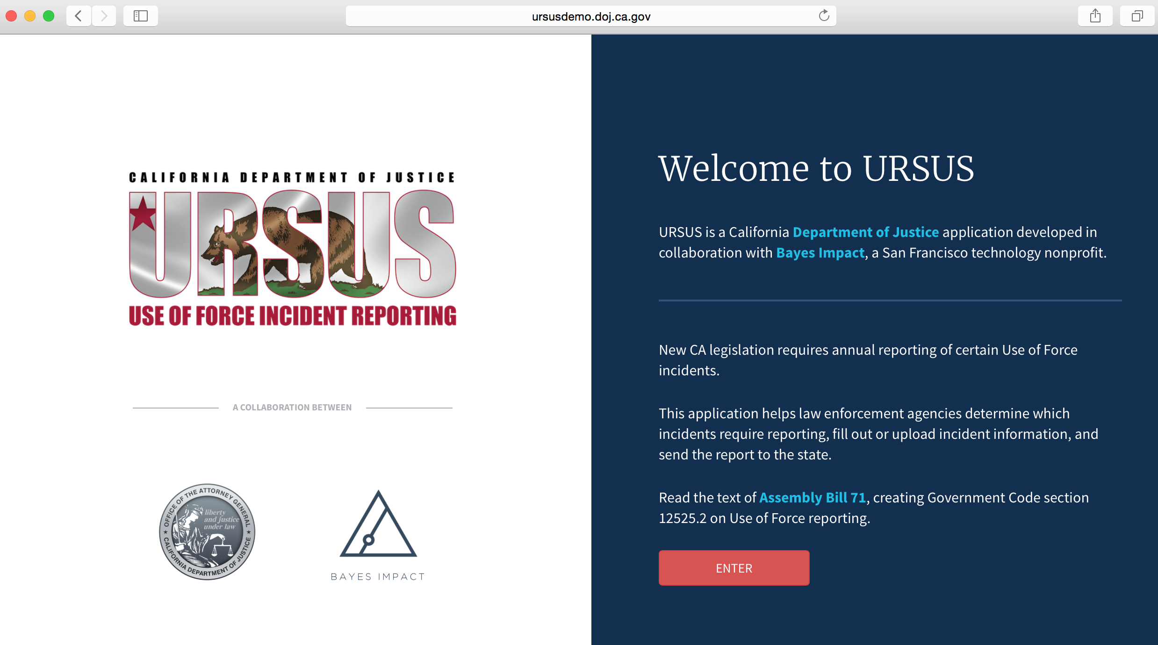
Recently launched Use of Force Data Collection & Reporting Tool

Slide 8
More datasets, tools, and collaborations are coming
The California DOJ sits on a treasure trove of data, so we will continue to add to OpenJustice to broaden the conversation.
These datasets will span the criminal justice lifecycle:
School-to-prison pipeline (e.g., Truancy)
Prosecution / Courts (e.g., violent felony conviction & non-violent diversions rates)
Incarceration & Rehabilitation (e.g., recidivism rates)
New data collection efforts ongoing on Use of Force and police traffic stop data

